Slide 1
Chapter 1: Web Development 101

Slide 2
Learning Objectives
Web Development 101:
HTTP and HTML
Webpage and it's components
Styling using CSS
Bootstrap introduction

Slide 3
Web Applications: So what happens, exactly?
When you type a web address into your browser (for our analogy that's like walking to the shop):
The browser goes to the DNS server, and finds the real address of the server that the website lives on (you find the address of the shop).
The browser sends an HTTP request message to the server, asking it to send a copy of the website to the client (you go to the shop and order your goods). This message, and all other data sent between the client and the server, is sent across your internet connection using TCP/IP.
Provided the server approves the client's request, the server sends the client a "200 OK" message, which means "Of course you can look at that website! Here it is", and then starts sending the website's files to the browser as a series of small chunks called data packets (the shop gives you your goods, and you bring them back to your house).
The browser assembles the small chunks into a complete website and displays it to you (the goods arrive at your door — new shiny stuff, awesome!).
Computers connected to the web are called clients and servers. A simplified diagram of how they interact might look like this:

Slide 4
The other parts of the toolbox
In addition to the client and the server, we also need to say hello to:
Your internet connection: Allows you to send and receive data on the web. It's basically like the street between your house and the shop.
TCP/IP: Transmission Control Protocol and Internet Protocol are communication protocols that define how data should travel across the web. This is like the transport mechanisms that let you place an order, go to the shop, and buy your goods. In our example, this is like a car or a bike (or however else you might get around).
DNS: Domain Name Servers are like an address book for websites. When you type a web address in your browser, the browser looks at the DNS to find the web site's real address before it can retrieve the website. The browser needs to find out which server the website lives on, so it can send HTTP messages to the right place (see below). This is like looking up the address of the shop so you can access it.
HTTP: Hypertext Transfer Protocol is an application protocol that defines a language for clients and servers to speak to each other. This is like the language you use to order your goods.
Component files: A website is made up of many different files, which are like the different parts of the goods you buy from the shop. These files come in two main types:
Code files: Websites are built primarily from HTML, CSS, and JavaScript, though you'll meet other technologies a bit later.
Assets: This is a collective name for all the other stuff that makes up a website, such as images, music, video, Word documents, and PDFs.

Slide 5
DNS explained
Real web addresses aren't the nice, memorable strings you type into your address bar to find your favorite websites. They are special numbers that look like this: 63.245.215.20.
This is called an IP address, and it represents a unique location on the Web. However, it's not very easy to remember, is it? That's why Domain Name Servers were invented. These are special servers that match up a web address you type into your browser (like "mozilla.org") to the website's real (IP) address.
Websites can be reached directly via their IP addresses. Try going to the Mozilla website by typing 63.245.215.20 into the address bar on a new browser tab.

Slide 6
HTTP — an Application-Level Protocol
On the Web, we have a very effective application protocol that prepares computers the world over for meaningful exchanges: Hypertext Transfer Protocol, or HTTP. HTTP is an application-level protocol on top of TCP/IP, a communication protocol. HTTP often seems to get forgotten about when teaching web design and development, which is a shame: understanding it will help you to define better user interactions, achieve better site performance and create effective tools for managing information on the Web.
Before looking at the specifics, let’s consider a basic communication scenario. To be able to communicate, two parties (be they software, devices, people, etc.) need:
Syntax (data format and coding)
Semantics (control information and error handling)
Timing (speed matching and sequencing)
HTTP has been defined to communicate information between two pieces of software via HTTP messages.
The way we shape and design these messages has consequences on the client (the browser for example), the server (web site) and their intermediaries (the proxy).

Slide 7
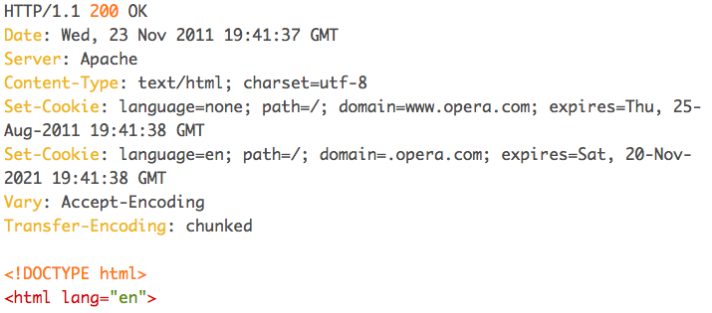
Let’s speak a bit of HTTP
Enter the following message into your terminal/command line:
telnet www.opera.com 80
Once this is done and the communication is established, type the following HTTP message quickly (before the connection automatically closes), then press enter/return twice:
GET / HTTP/1.1
Host: www.opera.com
This message specifies:
GET: That we wish to GET a representation of information.
/: That the information we want to get at is stored at the root of the site.
HTTP/1.1: We are speaking using HTTP version 1.1.
Host:: I’m trying to reach a specific site.
www.opera.com: the name of the site is www.opera.com.
Now it is time for the server to answer. You should see the terminal window fill up with content along these lines:

Slide 8
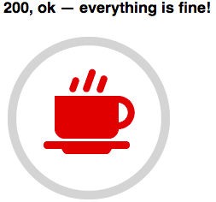
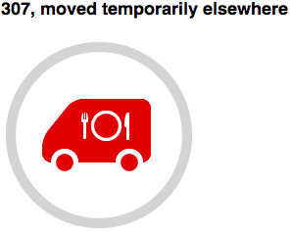
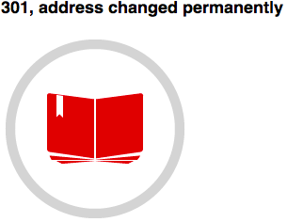
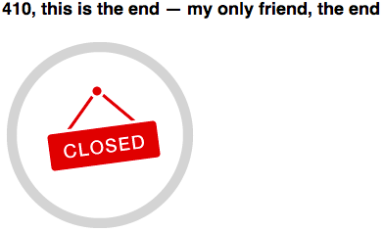
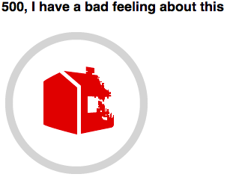
HTTP Response Codes:
The first line in the response is called the status-line. The line starts with the HTTP protocol version, a space, a 3-digit integer code, a space and finally an explanation sentence.
Above we have looked at just a few of the available HTTP codes; there are many others.
Some are very well-known, such as 404 Not Found, but others are quite obscure and don’t crop up very often.
Whatever the case, the first digit is always an indication of the family of codes they belong to:
1xx (Informational): Request received, continuing process.
2xx (Successful): The action was successfully received, understood, and accepted.
3xx (Redirection): Further action needs to be taken in order to complete the request.
4xx (Client Error): The request contains bad syntax or cannot be fulfilled.
5xx (Server Error): The server failed to fulfil an apparently valid request.

Slide 9
So what is HTML, really?
HTML is not a programming language; it is a markup language that defines the structure of your content. HTML consists of a series of elements, which you use to enclose, or wrap, different parts of the content to make it appear a certain way, or act a certain way.
The enclosing tags can make a word or image hyperlink to somewhere else, can italicize words, and can make font bigger or smaller, and so on.
The main parts of our element are:
The opening tag: This consists of the name of the element (in this case, p), wrapped in opening and closing angle brackets. This states where the element begins, or starts to take effect — in this case where the paragraph begins.
The closing tag: This is the same as the opening tag, except that it includes a forward slash before the element name. This states where the element ends — in this case where the end of the paragraph is. Failing to include a closing tag is one of the common beginner errors and can lead to strange results.
The content: This is the content of the element, which in this case is just text.
The element: The opening tag plus the closing tag plus the content equals the element.
Elements can also have attributes.
An attribute should always have:
A space between it and the element name (or the previous attribute, if the element already has one or more attributes).
The attribute name, followed by an equals sign.
Opening and closing quote marks wrapped around the attribute value.

Slide 10
So what is HTML, really?

Slide 11
Anatomy of an HTML document
That wraps up the basics of individual HTML elements, but they aren't very useful on their own. Now we'll look at how individual elements are combined to form an entire HTML page:
<!DOCTYPE html>: The doctype. In the mists of time, when HTML was young (about 1991/2), doctypes were meant to act as links to a set of rules that the HTML page had to follow to be considered good HTML, which could mean automatic error checking and other useful things. However, these days no one really cares about them, and they are really just a historical artifact that needs to be included for everything to work right.
<html></html>: The <html> element. This element wraps all the content on the entire page, and is sometimes known as the root element.
<head></head>: The <head> element. This element acts as a container for all the stuff you want to include on the HTML page that isn't the content you are showing to your page's viewers. This includes things like keywords and a page description that you want to appear in search results, CSS to style our content, character set declarations, and more.
<title></title>: The <title> element. This sets the title of your page, which is the title that appears in the browser tab the page is loaded in, and is used to describe the page when you bookmark/favourite it.
<body></body>: The <body> element. This contains all the content that you want to show to web users when they visit your page, whether that's text, images, videos, games, playable audio tracks, or whatever else.

Slide 12
Points to Remember about HTML
Whitespace in HTML: No matter how much whitespace you use (which can include space characters, but also line breaks), the HTML parser reduces each one down to a single space when rendering the code.
Here are some special characters and their equivalent HTML references:
Literal character | Character reference equivalent
< | &lt;
> | &gt;
" | &quot;
' | &apos;
& | &amp;
(white space) | &nbsp;

Slide 13
Introduction CSS
Cascading Style Sheets (CSS) is a stylesheet language used to describe the presentation of a document written in HTML or XML (including XML dialects such as SVG or XHTML). CSS describes how elements should be rendered on screen, on paper, in speech, or on other media.
Like HTML, CSS is not really a programming language. It is not a markup language either — it is a style sheet language. This means that it lets you apply styles selectively to elements in HTML documents.
The whole structure is called a rule set (but often "rule" for short). Note also the names of the individual parts:

Slide 14
Anatomy of a CSS ruleset
Selector:
The HTML element name at the start of the rule set. It selects the element(s) to be styled (in this case, p elements). To style a different element, just change the selector.
Declaration:
A single rule like color: red; specifying which of the element's properties you want to style.
Properties:
Ways in which you can style a given HTML element. (In this case, color is a property of the <p> elements.) In CSS, you choose which properties you want to affect in your rule.
Property value:
To the right of the property after the colon, we have the property value, which chooses one out of many possible appearances for a given property (there are many color values besides red).
Note the other important parts of the syntax:
Each rule set (apart from the selector) must be wrapped in curly braces ({}).
Within each declaration, you must use a colon (:) to separate the property from its values.
Within each rule set, you must use a semicolon (;) to separate each declaration from the next one.

Slide 15
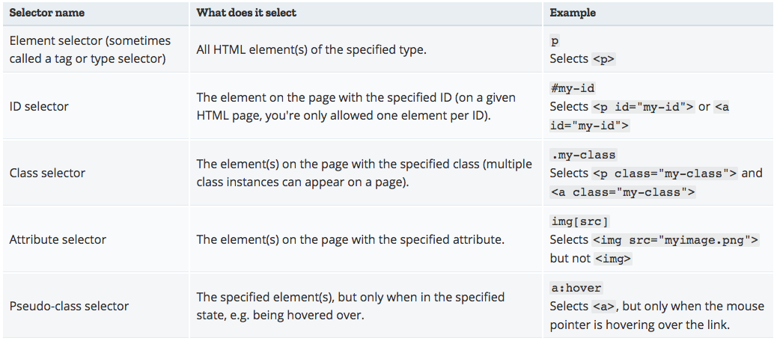
Different types of selector

Slide 16

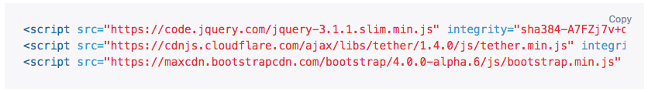
Introduction to Bootstrap
Bootstrap is the world’s most popular framework for building responsive, mobile-first sites and applications. Inside you’ll find high quality HTML, CSS, and JavaScript to make starting any project easier than ever.
Copy-paste the stylesheet <link> into your <head> before all other stylesheets to load bootstrap CSS.
Add bootstrap JavaScript plugins (we will learn this in next chapter), jQuery, and Tether near the end of your pages, right before the closing </body> tag. Be sure to place jQuery and Tether first, as bootstrap code depends on them.

Slide 17
Important globals: Bootstrap
Bootstrap employs a handful of important global styles and settings that you’ll need to be aware of when using it, all of which are almost exclusively geared towards the normalization of cross browser styles. Let’s dive in.
HTML5 doctype: Bootstrap requires the use of the HTML5 doctype. Without it, you’ll see some funky incomplete styling, but including it shouldn’t cause any considerable hiccups.
Responsive meta tag: Bootstrap is developed mobile first, a strategy in which we optimize code for mobile devices first and then scale up components as necessary using CSS media queries. To ensure proper rendering and touch zooming for all devices, add the responsive viewport meta tag to your <head>.
Box-sizing: For more straightforward sizing in CSS, we switch the global box-sizing value from content-box to border-box. This ensures padding does not affect the final computed width of an element, but it can cause problems with some third party software like Google Maps and Google Custom Search Engine.
Normalize.css: For improved cross-browser rendering, we can use Normalize.css to correct small inconsistencies across browsers and devices. Bootstrap further build on this with custom, slightly more opinionated styles with Reboot.

Slide 18
What are we learning in Next Chapter ?
You will learn about Advanced Web Development Concepts
We will learn about:
What is SASS?
CSS and SASS
Interactivity using Javascript
Javascript basics
JQuery
AJAX

Slide 19
Thank You !

